Slide 1
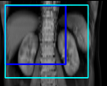
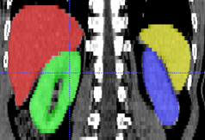
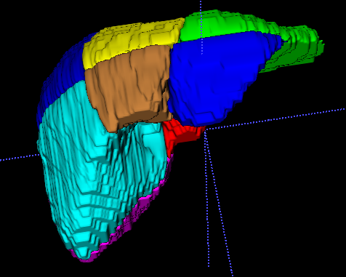
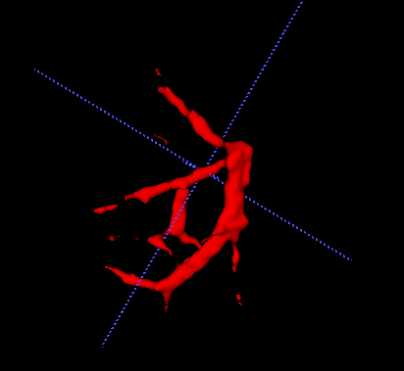
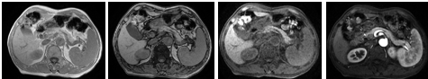
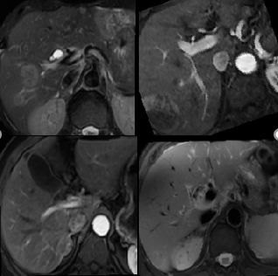
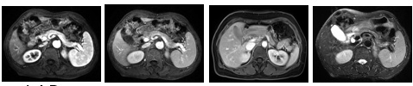
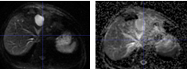
Liver Research
Multi-phases Abdominal Organs Detect
Multi-phases
Abdominal Organs
Segmentation
Liver segment seg &vessel seg
MR Sequence
Recognition
MR lesion detect

Slide 2
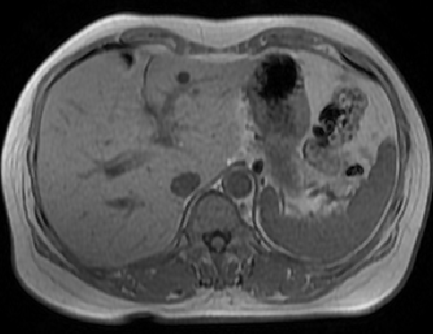
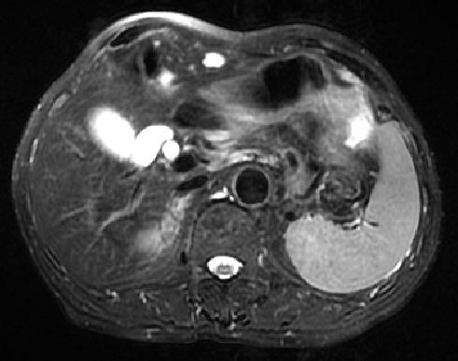
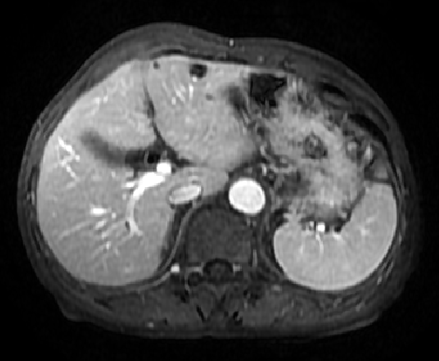
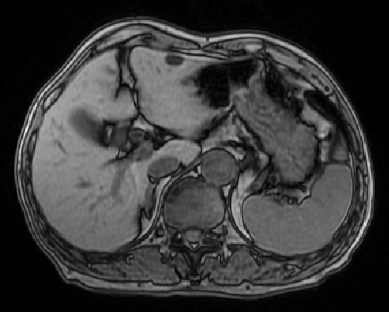
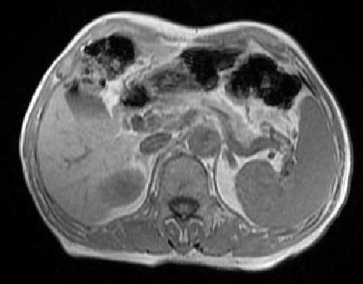
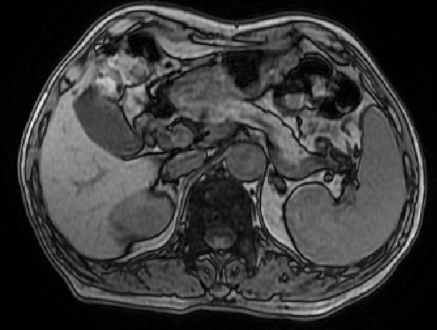
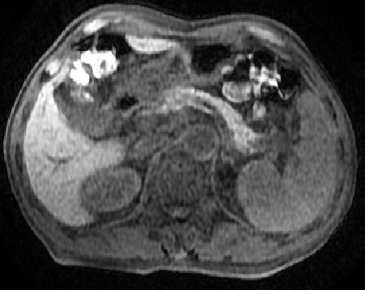
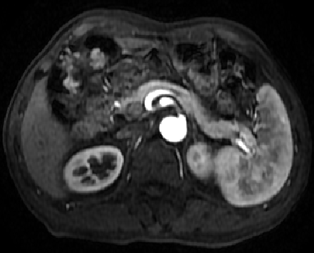
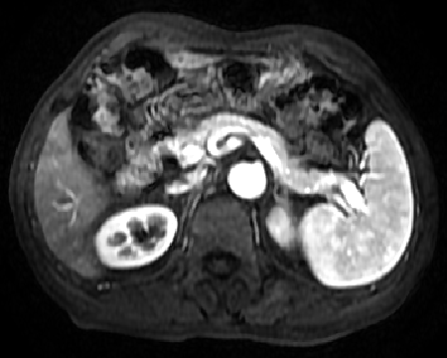
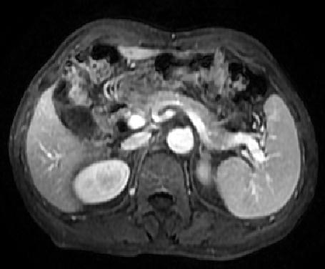
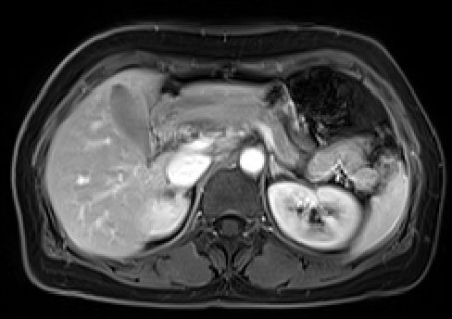
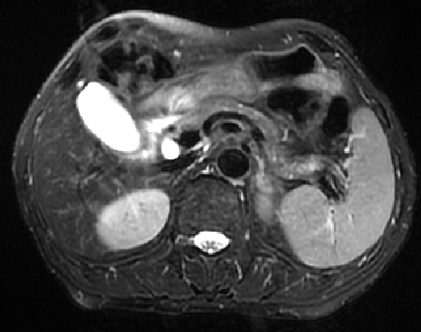
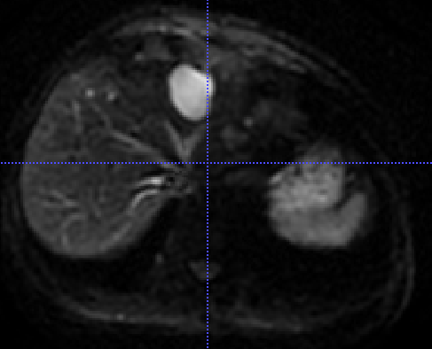
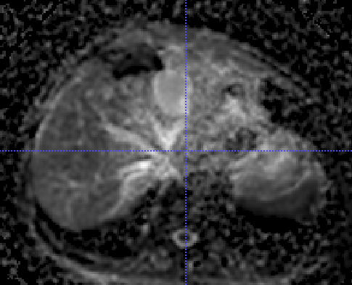
MR Sequence Recognition
sequence1
Sequence1 feature vector
sequence2
Dense block
Dense block
Sequence2 feature vector
All Sequence Features
Fusion module
sequence3
pooling
pooling
FC layer
Sequenc3 feature vector
…
…
sequencex
Sequencex feature vector
All labels
Automatic MR Sequences Re-order Module
Unordered Different
MR sequences
P0
P1
Pre-Artery
EAP
LAP
PV
Delay
T2
DWI
ADC

Slide 3
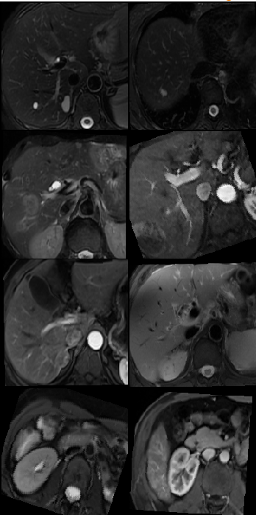
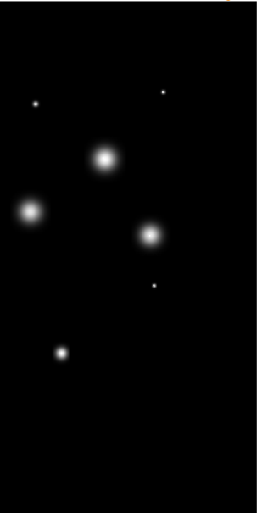
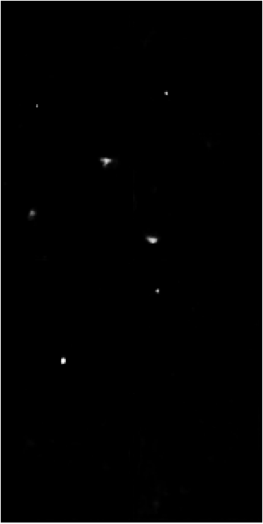
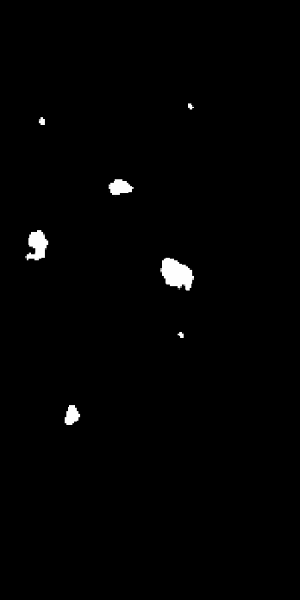
MR Liver Lesion Detect
原始图像（batchsize：8）
病灶中心热力图 (GT)
病灶中心检测结果
病灶分割结果
Center
Net
1.Heatmap
(focal loss)
2. Offset
(L1 loss)
3. DHW scale
(L1 loss)
4. Segmentation
(dice loss)
lesion detect simple pipeline

Slide 4
Lesion Detect dynamic result view
Lesion detect marked with red bounding box
Lesion center area detect marked with yellow mask
Lesion detect marked with red bounding box
Lesion center area detect marked with yellow mask
Lesion detect marked with red bounding box
Lesion center area detect marked with yellow mask

Slide 5
Thanks
for your attention

